Slide 1

School of Computer Science and Engineering
Program: BTech
Course Code: R1UC602C
Course Name: WEB TECHNOLOGY

Slide 2
School of Computing Science and Engineering Course Code : R1UC602C Course Name: Web Technology
Unit-2
FRONT END DESIGN USING CSS3 AND BOOTSTRAP FRAMEWORK
CSS : Types of CSS, CSS Properties -CSS3: Selector String, Box Model, Text Properties, CSS 3D Transformation, CSS Animation- Bootstrap Framework: BS Grid, Tables, Images, Alerts, Form Elements. Representing Web Data: Basic XML- DTD- Namespaces-XML Schema, DOM, XSL and XSLT Transformation- Case study: Online Blog Creation
Program Name: BTech

Slide 3
School of Computing Science and Engineering Course Code : R1UC602C Course Name: Web Technology
FRONT END DESIGN USING CSS3 AND BOOTSTRAP FRAMEWORK
Unit-2
CSS: Cascading Style Sheets
Cascading Style Sheets (CSS) is a stylesheet language used to describe the presentation of a document written in HTML or XML (including XML dialects such as SVG, MathML or XHTML).
CSS describes how elements should be rendered on screen, on paper, in speech, or on other media.
Program Name: BTech

Slide 4
School of Computing Science and Engineering Course Code : R1UC602C Course Name: Web Technology
FRONT END DESIGN USING CSS3 AND BOOTSTRAP FRAMEWORK
Unit-2
CSS Types
Internal CSS
External CSS
Inline CSS
Program Name: BTech

Slide 5
School of Computing Science and Engineering Course Code : R1UC602C Course Name: Web Technology
FRONT END DESIGN USING CSS3 AND BOOTSTRAP FRAMEWORK
Unit-2
CSS Types
Internal CSS
Internal or embedded CSS requires you to add a <style> tag in the <head> section of your HTML document.
This CSS style is an effective method of styling a single page. However, using this style for multiple pages is time-consuming as you need to put CSS rules on every page of your website.
Program Name: BTech

Slide 6
School of Computing Science and Engineering Course Code : R1UC602C Course Name: Web Technology
FRONT END DESIGN USING CSS3 AND BOOTSTRAP FRAMEWORK
Unit-2
Internal CSS
<html>
<head>
<style>
body { background-color: blue; }
h1 { color: red; padding: 60px; }
</style>
</head>
<body>
<h1>Hostinger Tutorials</h1>
<p>This is our paragraph.</p>
</body>
</html>
Program Name: BTech

Slide 7
School of Computing Science and Engineering Course Code : R1UC602C Course Name: Web Technology
FRONT END DESIGN USING CSS3 AND BOOTSTRAP FRAMEWORK
Unit-2
External CSS
With external CSS, you’ll link your web pages to an external .css file, which can be created by any text editor in your device .
This CSS type is a more efficient method, especially for styling a large website. By editing one .css file, you can change your entire site at once.
Follow these steps to use external CSS:
Program Name: BTech

Slide 8
School of Computing Science and Engineering Course Code : R1UC602C Course Name: Web Technology
FRONT END DESIGN USING CSS3 AND BOOTSTRAP FRAMEWORK
Unit-2
External CSS
Create a new .css file with the text editor, and add the style rules. For example:
.xleftcol { float: left; width: 33%; background:#809900; } .xmiddlecol { float: left; width: 34%; background:#eff2df; }
Program Name: BTech

Slide 9
School of Computing Science and Engineering Course Code : R1UC602C Course Name: Web Technology
FRONT END DESIGN USING CSS3 AND BOOTSTRAP FRAMEWORK
Unit-2
External CSS
In the <head> section of your HTML sheet, add a reference to your external .css file right after <title> tag:
<link rel="stylesheet" type="text/css" href="stylemodel.css" />
Advantages of External CSS:
Since the CSS code is in a separate document, your HTML files will have a cleaner structure and are smaller in size.
You can use the same .css file for multiple pages
Program Name: BTech

Slide 10
School of Computing Science and Engineering Course Code : R1UC602C Course Name: Web Technology
FRONT END DESIGN USING CSS3 AND BOOTSTRAP FRAMEWORK
Unit-2
Inline CSS
Inline CSS is used to style a specific HTML element. For this CSS style, you’ll only need to add the style attribute to each HTML tag, without using selectors.
This CSS type is not really recommended, as each HTML tag needs to be styled individually. Managing your website may become too hard if you only use inline CSS.
Program Name: BTech

Slide 11
School of Computing Science and Engineering Course Code : R1UC602C Course Name: Web Technology
FRONT END DESIGN USING CSS3 AND BOOTSTRAP FRAMEWORK
Unit-2
Inline CSS
However, inline CSS in HTML can be useful in some situations. For example, in cases where you don’t have access to CSS files or need to apply styles for a single element only.
Let’s take a look at an example. Here, we add an inline CSS to the <p> and <h1> tag:
<html> <body style="background-color:black;">
<h1 style="color:white;padding:30px;">Hostinger Tutorials</h1> <p style="color:white;">Something usefull here.</p> </body> </html>
Program Name: BTech

Slide 12
School of Computing Science and Engineering Course Code : R1UC602C Course Name: Web Technology
FRONT END DESIGN USING CSS3 AND BOOTSTRAP FRAMEWORK
Unit-2
Inline CSS
Advantages of Inline CSS:
You can easily and quickly insert CSS rules into an HTML page. That’s why this method is useful for testing or previewing the changes and performing quick fixes to your website.
You don’t need to create and upload a separate document as in the external style.
Internal or embedded ⁠– add <style> tag in the <head> section of HTML document
External ⁠– link the HTML sheet to a separate .css file
Inline ⁠– apply CSS rules for specific elements.
Program Name: BTech

Slide 13
School of Computing Science and Engineering Course Code : R1UC602C Course Name: Web Technology
FRONT END DESIGN USING CSS3 AND BOOTSTRAP FRAMEWORK
Unit-2
CSS Selectors
CSS Selectors targets the HTML elements on the Pages to add styles. CSS selectors select HTML elements according to their id, class, type, attribute, etc.
Selectors play a crucial role in defining the appearance and layout of web pages, enhancing both aesthetics and user experience.
Program Name: BTech

Slide 14
School of Computing Science and Engineering Course Code : R1UC602C Course Name: Web Technology
FRONT END DESIGN USING CSS3 AND BOOTSTRAP FRAMEWORK
Unit-2
CSS Selectors Types
CSS Selectors | Description
Simple Selectors | It is used to select the HTML elements based on their element name, id, attributes, etc
Universal Selector | Selects all elements on the page.
Attribute Selector | Targets elements based on their attribute values.
Pseudo-Class Selector | Selects elements based on their state or position, such as :hover for hover effects.
Combinator Selectors | Combine selectors to specify relationships between elements, such as descendants ( ) or child (>).
Pseudo-Element Selector | Selects specific parts of an element, such as ::before or ::after.
Program Name: BTech

Slide 15
School of Computing Science and Engineering Course Code : R1UC602C Course Name: Web Technology
FRONT END DESIGN USING CSS3 AND BOOTSTRAP FRAMEWORK
Unit-2
CSS Selectors Types
Simple Selectors
Simple Selector | Description
Element Selector | Selects HTML elements based on their tag names.
Id Selector | Targets an HTML element with a specific id attribute.
Class Selector | Selects elements with a particular class attribute.
Program Name: BTech

Slide 16
School of Computing Science and Engineering Course Code : R1UC602C Course Name: Web Technology
FRONT END DESIGN USING CSS3 AND BOOTSTRAP FRAMEWORK
Unit-2
CSS Selectors Types
Simple Selectors
<html lang="en">
<head>
<title>CSS Selectors</title>
<link rel="stylesheet" href="simpleselect.css" />
</head>
<body>
<h1>Sample Heading</h1>
<p>This is Content inside first paragraph</p>
<div id="div-container">
This is a div with id div-container
</div>
<p class="paragraph-class">
This is a paragraph with class paragraph-class
</p>
</body>
</html>
Note: We will apply CSS rules to the above Example.
Program Name: BTech

Slide 17
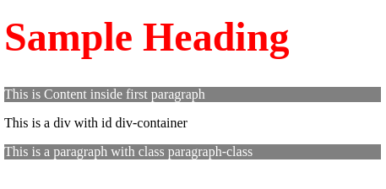
School of Computing Science and Engineering Course Code : R1UC602C Course Name: Web Technology
FRONT END DESIGN USING CSS3 AND BOOTSTRAP FRAMEWORK
Unit-2
CSS Selectors Types
Element Selector
The element selector selects HTML elements based on the element name (or tag) for example p, h1, div, span, etc.
CSS:
h1 { color: red; font-size: 3rem;
}
p { color: white; background-color: gray;
}
Program Name: BTech

Slide 18
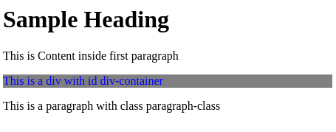
School of Computing Science and Engineering Course Code : R1UC602C Course Name: Web Technology
FRONT END DESIGN USING CSS3 AND BOOTSTRAP FRAMEWORK
Unit-2
CSS Selectors Types
Id Selector
The id selector uses the id attribute of an HTML element to select a specific element. An id of the element is unique on a page to use the id selector.
#div-container{ color: blue; background-color: gray; }
Program Name: BTech

Slide 19
School of Computing Science and Engineering Course Code : R1UC602C Course Name: Web Technology
FRONT END DESIGN USING CSS3 AND BOOTSTRAP FRAMEWORK
Unit-2
CSS Selectors Types
Class Selector
The class selector selects HTML elements with a specific class attribute.
Note: The following code is used in the above Example using the class selector. To use a class selector you must use ( . ) followed by class name in CSS. This rule will be applied to the HTML element with the class attribute “paragraph-class“
Program Name: BTech

Slide 20
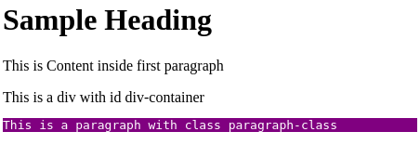
School of Computing Science and Engineering Course Code : R1UC602C Course Name: Web Technology
FRONT END DESIGN USING CSS3 AND BOOTSTRAP FRAMEWORK
Unit-2
CSS Selectors Types
Class Selector
CSS:
.paragraph-class { color:white; font-family: monospace; background-color: purple; }
Program Name: BTech

Slide 21
School of Computing Science and Engineering Course Code : R1UC602C Course Name: Web Technology
FRONT END DESIGN USING CSS3 AND BOOTSTRAP FRAMEWORK
Unit-2
CSS Selectors Types
Universal Selector
The Universal selector (*) in CSS is used to select all the elements in an HTML document. It also includes other elements which are inside under another element.
Note: The following code is used in the above Example using the universal selector. This CSS rule will be applied to every HTML element on the page:
Program Name: BTech

Slide 22
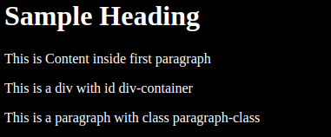
School of Computing Science and Engineering Course Code : R1UC602C Course Name: Web Technology
FRONT END DESIGN USING CSS3 AND BOOTSTRAP FRAMEWORK
Unit-2
CSS Selectors Types
Universal Selector
CSS:
* { color: white; background-color: black; }
Program Name: BTech

Slide 23
School of Computing Science and Engineering Course Code : R1UC602C Course Name: Web Technology
FRONT END DESIGN USING CSS3 AND BOOTSTRAP FRAMEWORK
Unit-2
CSS Selectors Types
Group Selector
The Group selector is used to style all comma-separated elements with the same style.
Note: Suppose you want to apply common styles to different selectors, instead of writing rules separately you can write them in groups as shown below.
Program Name: BTech

Slide 24
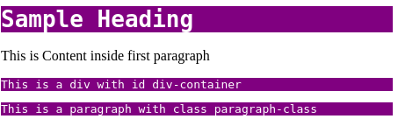
School of Computing Science and Engineering Course Code : R1UC602C Course Name: Web Technology
FRONT END DESIGN USING CSS3 AND BOOTSTRAP FRAMEWORK
Unit-2
CSS Selectors Types
CSS:
#div-container, .paragraph-class, h1{ color: white; background-color: purple; font-family: monospace; }
Program Name: BTech

Slide 25
School of Computing Science and Engineering Course Code : R1UC602C Course Name: Web Technology
FRONT END DESIGN USING CSS3 AND BOOTSTRAP FRAMEWORK
Unit-2
CSS Selectors Types
Attribute Selector
The attribute selector [attribute] is used to select the elements with a specified attribute or attribute value.
Note: The following code is used in the above Example using the attribute selector. This CSS rule will be applied to every HTML element on the page:
CSS:
[href] { background-color: lightgreen; color: black; font-family: monospace; font-size: 1rem; }
Program Name: BTech

Slide 26
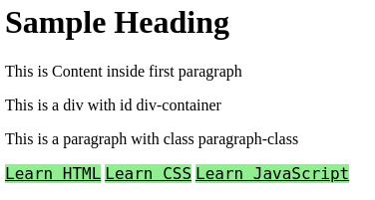
School of Computing Science and Engineering Course Code : R1UC602C Course Name: Web Technology
FRONT END DESIGN USING CSS3 AND BOOTSTRAP FRAMEWORK
Unit-2
CSS Selectors Types
Attribute Selector
Program Name: BTech

Slide 27
School of Computing Science and Engineering Course Code : R1UC602C Course Name: Web Technology
FRONT END DESIGN USING CSS3 AND BOOTSTRAP FRAMEWORK
Unit-2
CSS Selectors Types
Attribute Selector
Pseudo-Class Selector
It is used to style a special type of state of any element. For example- It is used to style an element when a mouse cursor hovers over it.
Note: We use a single colon(:) in the case of a Pseudo-Class Selector.
Syntax:
Selector:Pseudo-Class { Property: Value; }
Program Name: BTech

Slide 28
School of Computing Science and Engineering Course Code : R1UC602C Course Name: Web Technology
FRONT END DESIGN USING CSS3 AND BOOTSTRAP FRAMEWORK
Unit-2
CSS Selectors Types
Pseudo-Class Selector
CSS:
h1:hover{ background-color: aqua; }
Output:
Program Name: BTech

Slide 29
School of Computing Science and Engineering Course Code : R1UC602C Course Name: Web Technology
FRONT END DESIGN USING CSS3 AND BOOTSTRAP FRAMEWORK
Unit-2
CSS Selectors Types
Pseudo-Element Selector
It is used to style any specific part of the element. For Example- It is used to style the first letter or the first line of any element.
Note: We use a double colon(::) in the case of a Pseudo-Element Selector.
Syntax:
Selector:Pseudo-Element{ Property:Value; }
Program Name: BTech

Slide 30
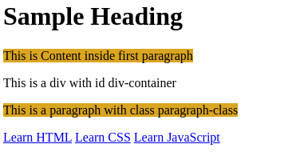
School of Computing Science and Engineering Course Code : R1UC602C Course Name: Web Technology
FRONT END DESIGN USING CSS3 AND BOOTSTRAP FRAMEWORK
Unit-2
CSS Selectors Types
Pseudo-Element Selector
CSS:
p::first-line{ background-color: goldenrod; }
Output:
Program Name: BTech

Slide 31
School of Computing Science and Engineering Course Code : R1UC602C Course Name: Web Technology
FRONT END DESIGN USING CSS3 AND BOOTSTRAP FRAMEWORK
Unit-2
CSS Box model
CSS Box Model is a Fundamental concept in CSS that governs how elements are structured and positioned on a webpage. By learning this model, you’ll create elements visually appealing that adjust seamlessly to various screen sizes. It is used to create the design and layout of web pages.
What is the CSS Box Model?
The box model in CSS is a container that contains various properties, including borders, margins, padding, and the content itself. These properties collectively determine the dimensions and spacing of an element.
Program Name: BTech

Slide 32
School of Computing Science and Engineering Course Code : R1UC602C Course Name: Web Technology
FRONT END DESIGN USING CSS3 AND BOOTSTRAP FRAMEWORK
Unit-2
CSS Box model
Content: The actual data in text, images, or other media forms can be sized using the width and height property.
Padding: Padding is used to create space around the element, inside any defined border.
Border: The border is used to cover the content & any padding, & also allows setting the style, color, and width of the border.
Margin: Margin is used to create space around the element ie., around the border area.
Program Name: BTech

Slide 33
School of Computing Science and Engineering Course Code : R1UC602C Course Name: Web Technology
FRONT END DESIGN USING CSS3 AND BOOTSTRAP FRAMEWORK
Unit-2
CSS Box model
1. Content Area
Contains the actual data, such as text, images, or other media.
Sized using the width and height properties.
Bounded by the content edge.
2. Padding Area
Surrounds the content area.
Space within the border box.
Dimensions are determined by the width and height of the padding box.
Program Name: BTech

Slide 34
School of Computing Science and Engineering Course Code : R1UC602C Course Name: Web Technology
FRONT END DESIGN USING CSS3 AND BOOTSTRAP FRAMEWORK
Unit-2
CSS Box model
3. Border Area
Lies between the padding and margin.
Width and height are defined by the border.
4. Margin Area
Separates the element from neighboring elements.
Dimensions specified by the margin-box width and height.
Program Name: BTech

Slide 35
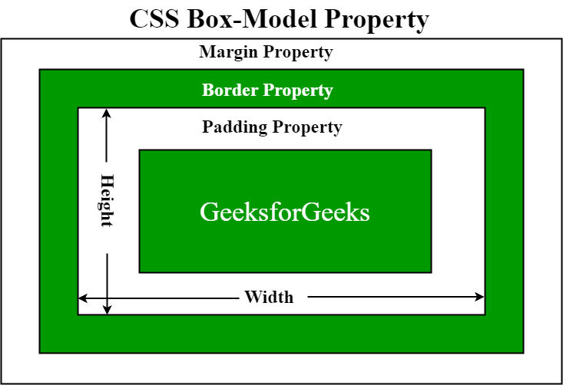
School of Computing Science and Engineering Course Code : R1UC602C Course Name: Web Technology
FRONT END DESIGN USING CSS3 AND BOOTSTRAP FRAMEWORK
Unit-2
CSS Box model
Program Name: BTech

Slide 36
School of Computing Science and Engineering Course Code : R1UC602C Course Name: Web Technology
FRONT END DESIGN USING CSS3 AND BOOTSTRAP FRAMEWORK
Unit-2
CSS Box model
p { width: 80px; height: 70px; margin: 0; border: 2px solid black; padding: 5px; }
Program Name: BTech

Slide 37
School of Computing Science and Engineering Course Code : R1UC602C Course Name: Web Technology
FRONT END DESIGN USING CSS3 AND BOOTSTRAP FRAMEWORK
Unit-2
Text Properties
Property | Description | Values
color | Sets the color of a text | RGB, hex, keyword
line-height | Sets the distance between lines | normal, number, length, %
letter-spacing | Increase or decrease the space between characters | normal, length
text-align | Aligns the text in an element | left, right, center, justify
text-decoration | Adds decoration to text | none, underline, overline, line-through
text-indent | Indents the first line of text in an element | length, %
text-transform | Controls the letters in an element | none, capitalize, uppercase, lowercase
Program Name: BTech

Slide 38
School of Computing Science and Engineering Course Code : R1UC602C Course Name: Web Technology
FRONT END DESIGN USING CSS3 AND BOOTSTRAP FRAMEWORK
Unit-2
CSS 3D Transforms
It allows changing elements using 3D transformations. In 3D transformation, the elements are rotated along X-axis, Y-axis, and Z-axis. There are three main types of transformation which are listed below:
rotateX()
rotateY()
rotateZ()
The rotateX() Method: This rotation is used to rotate an element around X-axis at a given degree.
Example: This example shows the use of the rotateX() method.
Program Name: BTech

Slide 39
School of Computing Science and Engineering Course Code : R1UC602C Course Name: Web Technology
FRONT END DESIGN USING CSS3 AND BOOTSTRAP FRAMEWORK
Unit-2
CSS 3D Transforms
Code
Program Name: BTech

Slide 40
School of Computing Science and Engineering Course Code : R1UC602C Course Name: Web Technology
FRONT END DESIGN USING CSS3 AND BOOTSTRAP FRAMEWORK
Unit-2
CSS 3D Transforms
The rotateY() Method: This method is used to rotate an element around Y-axis at given degrees.
Example: This example shows the use of the rotateY() method.
Code
Program Name: BTech

Slide 41
School of Computing Science and Engineering Course Code : R1UC602C Course Name: Web Technology
FRONT END DESIGN USING CSS3 AND BOOTSTRAP FRAMEWORK
Unit-2
CSS 3D Transforms
The rotateZ() Method: This method is used to rotate an element around Z-axis at a given degree.
Example: This example shows the use of the rotateZ() method.
Code
Program Name: BTech

Slide 42
School of Computing Science and Engineering Course Code : R1UC602C Course Name: Web Technology
FRONT END DESIGN USING CSS3 AND BOOTSTRAP FRAMEWORK
Unit-2
CSS Animations
CSS Animations allows to control the elements by changing their motions or display. Animation is a technique to change the appearance and behaviour of various elements in web pages.
It has two parts, one contains the CSS properties which describe the animation of the elements and the other contains certain keyframes which indicate the animation properties of the element and the specific time intervals at which those have to occur.
Program Name: BTech

Slide 43
School of Computing Science and Engineering Course Code : R1UC602C Course Name: Web Technology
FRONT END DESIGN USING CSS3 AND BOOTSTRAP FRAMEWORK
Unit-2
CSS Animations
Property | Description
animation-name | It is used to specify the name of the @keyframes describing the animation.
animation-duration | It is used to specify the time duration it takes animation to complete one cycle.
animation-timing-function | It specifies how animations make transitions through keyframes. There are several presets available in CSS which are used as the value for the animation-timing-function like linear, ease,ease-in,ease-out, and ease-in-out.
Program Name: BTech

Slide 44
School of Computing Science and Engineering Course Code : R1UC602C Course Name: Web Technology
FRONT END DESIGN USING CSS3 AND BOOTSTRAP FRAMEWORK
Unit-2
CSS Animations
animation-delay | It specifies the delay of the start of an animation.
animation-iteration-count | This specifies the number of times the animation will be repeated.
animation-direction | It defines the direction of the animation. animation direction can be normal, reverse, alternate, and alternate-reverse.
animation-fill-mode | It defines how styles are applied before and after animation. The animation fill mode can be none, forwards, backwards, or both.
animation-play-state | This property specifies whether the animation is running or paused.
Program Name: BTech

Slide 45
School of Computing Science and Engineering Course Code : R1UC602C Course Name: Web Technology
FRONT END DESIGN USING CSS3 AND BOOTSTRAP FRAMEWORK
Unit-2
CSS Animations
The animation-name property is used to specify the name of the @keyframes describing the animation.
Syntax:
animation-name: keyframename|none|initial|inherit;
Property Value: The animation-name property value are listed below:
keyframename: This property is used to specify the name of the keyframe which need to bind with selector.
none: It is the default value. It is used to specify that there will be no animation.
initial: This property is used to set this property to its default value.
inherit: This property is used to inherits this property from its parent element.
CSS animation-name Property
Program Name: BTech

Slide 46
School of Computing Science and Engineering Course Code : R1UC602C Course Name: Web Technology
FRONT END DESIGN USING CSS3 AND BOOTSTRAP FRAMEWORK
Unit-2
CSS Animations
The animation-duration property in CSS is used to define how long an animation should take to complete one cycle. That is it is used to specify the time duration for which animation will be played.
Syntax:
animation-duration: time|initial|inherit;
Property Value:
time: This value is used to specify the length of time for which an animation will complete one cycle. This can be specified in either in seconds or in milliseconds. The default value is 0, which means that no animation will occur.
initial: This value is used to set the property to its default value.
inherit: This value is used to inherit the property from its parent element.
CSS animation-duration Property
Program Name: BTech

Slide 47
School of Computing Science and Engineering Course Code : R1UC602C Course Name: Web Technology
FRONT END DESIGN USING CSS3 AND BOOTSTRAP FRAMEWORK
Unit-2
CSS Animations
The animation-timing-function property in CSS is used to specify how the animation makes transitions through keyframes. That is, it is used to specify the motion of animation during transitions.
Syntax:
animation-timing-function: linear | ease | ease-in | ease-out | ease-in-out |step-start | step-end| steps(int, start | end) | cubic-bezier(n, n, n, n) | initial | inherit;
Property Value:
ease: With this property value, the animation starts slowly, then fast, and then finally ends slowly (this is default).
linear: If this value is specified for the property then the animation plays with the same speed from start to end.
ease-in: If this value is specified then the animation begins with a slow start.
ease-out: If this value is specified for the property then the animation plays normally but ends slow. This is similar to ease-in.
ease-in-out: With this property value, the animation both starts and ends slow.
Program Name: BTech

Slide 48
School of Computing Science and Engineering Course Code : R1UC602C Course Name: Web Technology
FRONT END DESIGN USING CSS3 AND BOOTSTRAP FRAMEWORK
Unit-2
CSS Animations
The animation-delay property in CSS is used to specify the delay for the start of an animation. The animation-delay value is defined in seconds (s) or milliseconds (ms).
Syntax:
animation-delay: time|initial|inherit;
Property Values:
time: This value is optional. It is used to define the number of seconds (s) or milliseconds (ms) to wait before the animation will start, that is the amount of time for which the animation will be delayed. The default value is 0. Negative values are allowed. If a negative value is used, the animation will start as if it had already been playing for N seconds/milliseconds.
initial: This value is used to set the property to its default value.
inherit: This value is used to inherits the property from its parent element.
CSS animation-delay Property
Program Name: BTech

Slide 49
School of Computing Science and Engineering Course Code : R1UC602C Course Name: Web Technology
FRONT END DESIGN USING CSS3 AND BOOTSTRAP FRAMEWORK
Unit-2
CSS Animations
The animation-iteration-count property in CSS is used to specify the number of times the animation will be repeated. It can specify as infinite to repeat the animation indefinitely.
Syntax:
animation-iteration-count: number|infinite|initial|inherit;
Property Value:
number: This property value is used to define the number of times an animation should be played. The default value is 1.
infinite: This property value specifies that the animation should be played infinite times (forever).
initial: This property value is used to set this property to its default value.
inherit: This value is used to inherit this property from its parent element.
CSS animation-iteration-count Property
Program Name: BTech

Slide 50
School of Computing Science and Engineering Course Code : R1UC602C Course Name: Web Technology
FRONT END DESIGN USING CSS3 AND BOOTSTRAP FRAMEWORK
Unit-2
CSS Animations
The animation-direction property in CSS is used to define the direction of the animation. The direction of animation should be forwards, backward, or in alternate cycles.
Syntax:
animation-direction: normal|reverse|alternate|alternate-reverse| initial|inherit;
Property Value: The animation-direction property are listed below:
normal: This animation property plays the animation forward. It is the default value.
reverse: This animation property plays the animation in the reverse direction.
alternate: This animation property plays the animation forwards first, and then backward.
alternate-reverse: This animation property play animation backwards first, and then forwards.
initial: This property is used to set the animation property to its default value.
inherit: This property is used to inherit the animation property from its parent element.
CSS animation-direction Property
Program Name: BTech

Slide 51
School of Computing Science and Engineering Course Code : R1UC602C Course Name: Web Technology
FRONT END DESIGN USING CSS3 AND BOOTSTRAP FRAMEWORK
Unit-2
CSS Animations
The animation-fill-mode property is used to specify the values that are applied by the animation before and after it is executed. Before playing the first keyframe or after playing the last keyframe CSS animations do not affect the element. The animation-fill-mode property can override this behavior.
Syntax:
animation-fill-mode: none | forwards | backwards | both | initial | inherit;
Property Value: The animation-fill-mode property contains many values which are listed below:
none: It is the default value. The animation properties will not apply to any element before or after it is executed.
forwards: The element will retain the same animation properties of the last keyframe after the animation completes.
backwards: This property value is used to set the element to the first keyframe value before starting the animation.
both: This property is used to follow the rules for both forwards and backward.
initial: This property is used to set the property to its default value.
inherit: This property is used to inherit this property from its parent element.
CSS animation-fill-mode Property
Program Name: BTech

Slide 52
School of Computing Science and Engineering Course Code : R1UC602C Course Name: Web Technology
FRONT END DESIGN USING CSS3 AND BOOTSTRAP FRAMEWORK
Unit-2
CSS Animations
The animation-play-state property is used to specify whether the animation is running or paused.
Syntax:
animation-play-state: paused|running|initial|inherit;
Property Value: The animation-play-state property are listed below:
paused: This property is used to specify that the animation is paused.
running: It is the default value. This property is used to specify that the animation is running.
initial: This property is used to set its default value.
inherit: It is used to inherit the animation property from its parent.
CSS animation-play-state Property
Program Name: BTech

Slide 53
School of Computing Science and Engineering Course Code : R1UC602C Course Name: Web Technology
FRONT END DESIGN USING CSS3 AND BOOTSTRAP FRAMEWORK
Unit-2
BOOTSTRAP FRAMEWORK
Bootstrap is a widely-used open-source front-end framework for web development, providing a collection of HTML, CSS, and JavaScript components and tools that enable developers to build responsive, mobile-first websites with ease.
Program Name: BTech

Slide 54
School of Computing Science and Engineering Course Code : R1UC602C Course Name: Web Technology
FRONT END DESIGN USING CSS3 AND BOOTSTRAP FRAMEWORK
Unit-2
BOOTSTRAP FRAMEWORK
Bootstrap is a free and open-source tool collection for creating responsive websites and web applications.
It is the most popular HTML, CSS, and JavaScript framework for developing responsive, mobile-first websites. Nowadays, the websites are perfect for all browsers (IE, Firefox, and Chrome) and for all sizes of screens (Desktop, Tablets, Phablets, and Phones).
Program Name: BTech

Slide 55
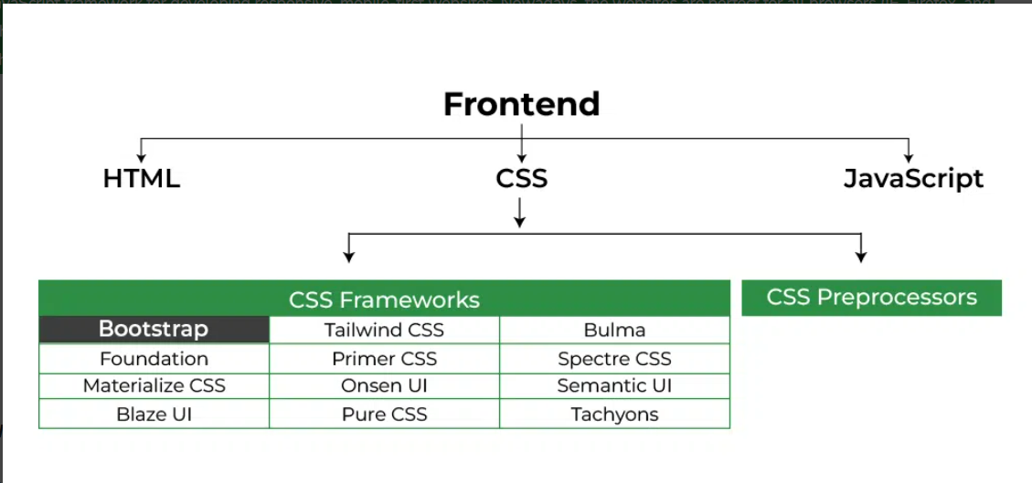
School of Computing Science and Engineering Course Code : R1UC602C Course Name: Web Technology
FRONT END DESIGN USING CSS3 AND BOOTSTRAP FRAMEWORK
Unit-2
BOOTSTRAP FRAMEWORK
Program Name: BTech

Slide 56
School of Computing Science and Engineering Course Code : R1UC602C Course Name: Web Technology
FRONT END DESIGN USING CSS3 AND BOOTSTRAP FRAMEWORK
Unit-2
BOOTSTRAP FRAMEWORK
By using this framework we can easily manipulate the styling of any web page, like font style, text color, background color, flex, grid system, etc.
Bootstrap Version 4 & Version 5 are the most popular versions. There are lots of other CSS frameworks like Tailwind CSS, Bulma, and Foundation but among them, this framework is the most popular because of below mentioned features:
It is a Faster and Easier way for Web-Development.
It creates Platform-independent web pages.
It creates Responsive web pages.
It designs responsive web pages for mobile devices too.
It is a free and open-source framework available on www.getbootstrap.com
Program Name: BTech

Slide 57
School of Computing Science and Engineering Course Code : R1UC602C Course Name: Web Technology
FRONT END DESIGN USING CSS3 AND BOOTSTRAP FRAMEWORK
Unit-2
BOOTSTRAP FRAMEWORK
Applications of Bootstrap
Responsive Web Design: Bootstrap empowers developers to create websites that seamlessly adapt to different screen sizes and devices, providing a consistent and optimal user experience.
Mobile-First Development: Bootstrap’s mobile-first approach ensures that websites are designed and optimized for mobile devices, catering to the increasing usage of smartphones and tablets.
Efficient Prototyping: With its extensive collection of pre-designed components and templates, Bootstrap facilitates rapid prototyping, enabling developers to quickly create functional website layouts and UIs.
Program Name: BTech

Slide 58
School of Computing Science and Engineering Course Code : R1UC602C Course Name: Web Technology
FRONT END DESIGN USING CSS3 AND BOOTSTRAP FRAMEWORK
Unit-2
BOOTSTRAP FRAMEWORK
Applications of Bootstrap
Consistent Cross-Browser Compatibility: Bootstrap’s standardized CSS and JavaScript codebase ensures consistent rendering and functionality across various web browsers, saving developers time and effort in browser-specific troubleshooting.
Customizable Themes and Styling: Bootstrap offers a wide range of customizable themes and styles, allowing developers to create visually appealing and unique designs that align with their brand or project requirements.
Time and Cost Efficiency: By leveraging the power of Bootstrap, developers can save significant time and effort in front-end development, resulting in faster project delivery and cost savings.
Program Name: BTech

Slide 59
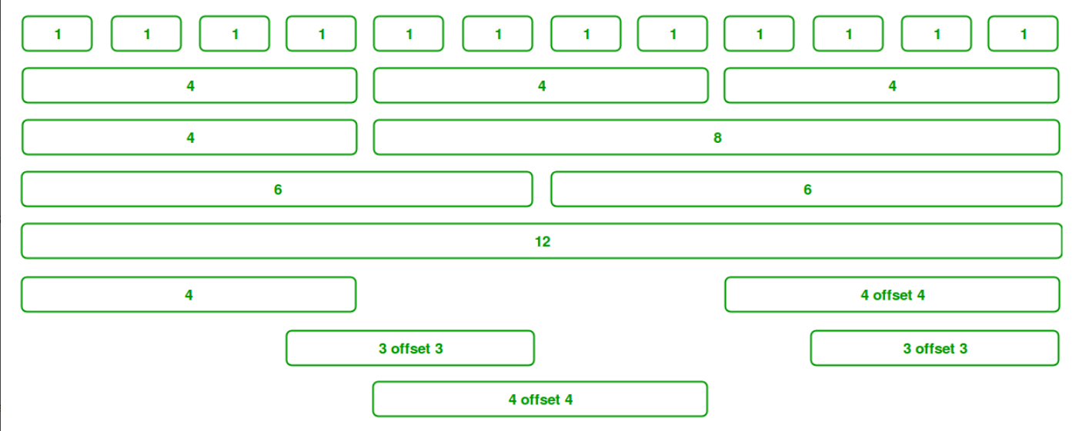
School of Computing Science and Engineering Course Code : R1UC602C Course Name: Web Technology
FRONT END DESIGN USING CSS3 AND BOOTSTRAP FRAMEWORK
Unit-2
BOOTSTRAP FRAMEWORK
Grid System: Bootstrap Grid System allows up to 12 columns across the page. You can use each of them individually or merge them together for wider columns. You can use all combinations of values summing up to 12. You can use 12 columns each of width 1, or use 4 columns each of width 3 or any other combination.
Program Name: BTech

Slide 60
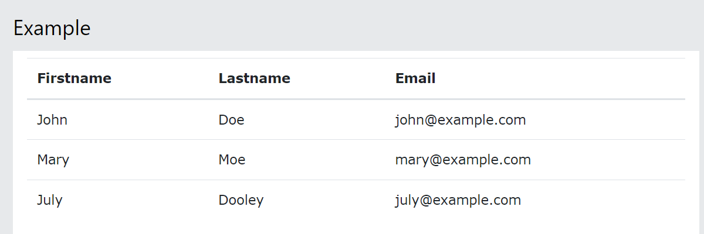
School of Computing Science and Engineering Course Code : R1UC602C Course Name: Web Technology
FRONT END DESIGN USING CSS3 AND BOOTSTRAP FRAMEWORK
Unit-2
BOOTSTRAP FRAMEWORK
Bootstrap Basic Table
A basic Bootstrap table has a light padding and horizontal dividers.
The .table class adds basic styling to a table:
Program Name: BTech

Slide 61
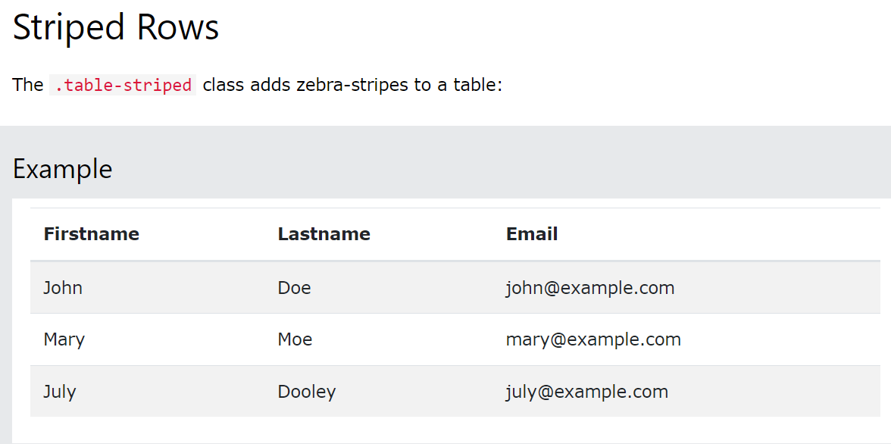
School of Computing Science and Engineering Course Code : R1UC602C Course Name: Web Technology
FRONT END DESIGN USING CSS3 AND BOOTSTRAP FRAMEWORK
Unit-2
BOOTSTRAP FRAMEWORK
Bootstrap Basic Table
Program Name: BTech

Slide 62
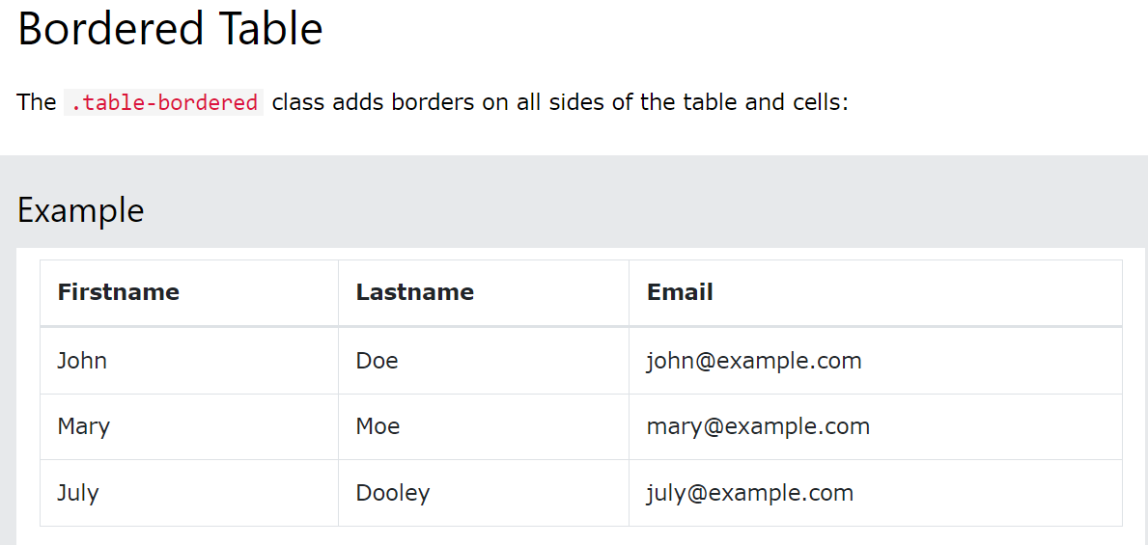
School of Computing Science and Engineering Course Code : R1UC602C Course Name: Web Technology
FRONT END DESIGN USING CSS3 AND BOOTSTRAP FRAMEWORK
Unit-2
BOOTSTRAP FRAMEWORK
Bootstrap Basic Table
Program Name: BTech

Slide 63
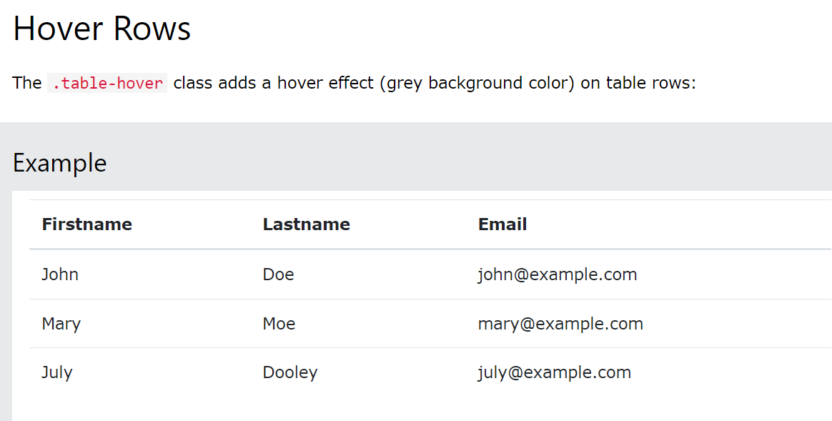
School of Computing Science and Engineering Course Code : R1UC602C Course Name: Web Technology
FRONT END DESIGN USING CSS3 AND BOOTSTRAP FRAMEWORK
Unit-2
BOOTSTRAP FRAMEWORK
Bootstrap Basic Table
Program Name: BTech

Slide 64
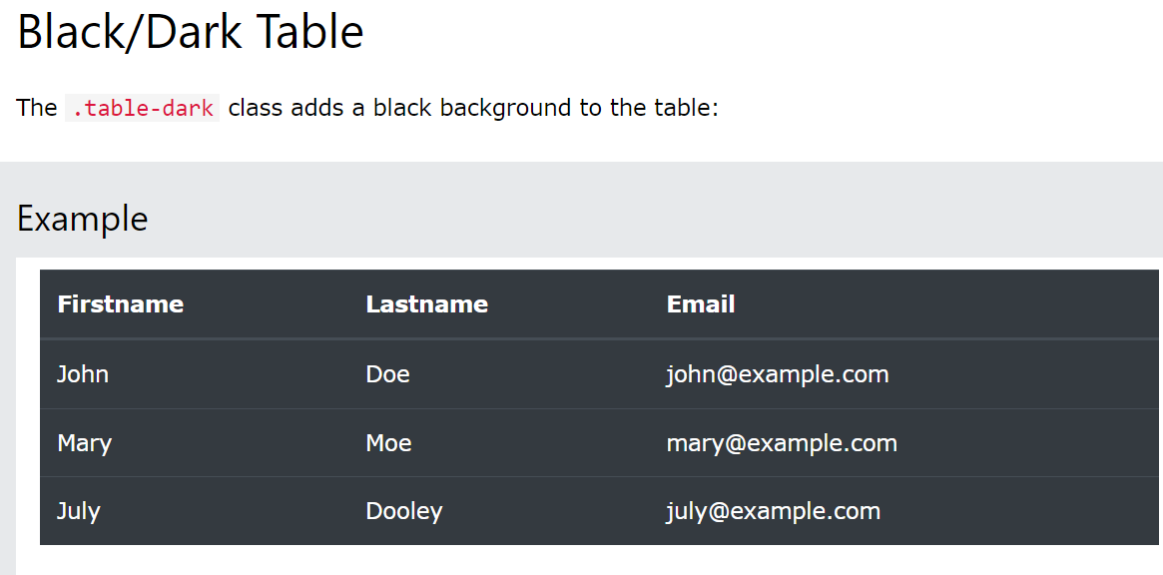
School of Computing Science and Engineering Course Code : R1UC602C Course Name: Web Technology
FRONT END DESIGN USING CSS3 AND BOOTSTRAP FRAMEWORK
Unit-2
BOOTSTRAP FRAMEWORK
Bootstrap Basic Table
Program Name: BTech

Slide 65
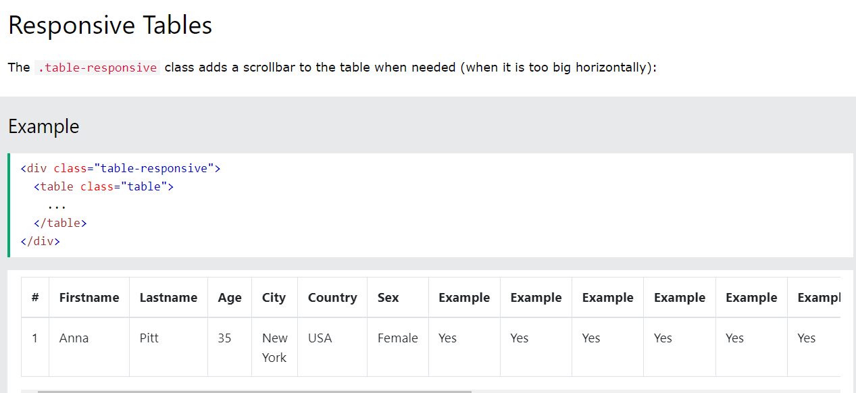
School of Computing Science and Engineering Course Code : R1UC602C Course Name: Web Technology
FRONT END DESIGN USING CSS3 AND BOOTSTRAP FRAMEWORK
Unit-2
BOOTSTRAP FRAMEWORK
Bootstrap Basic Table
Program Name: BTech

Slide 66

School of Computing Science and Engineering Course Code : R1UC602C Course Name: Web Technology
FRONT END DESIGN USING CSS3 AND BOOTSTRAP FRAMEWORK
Unit-2
BOOTSTRAP FRAMEWORK
Bootstrap Image Shapes
Rounded Corners
The .rounded class adds rounded corners to an image:
Example
<img src="cinqueterre.jpg" class="rounded" alt="Cinque Terre">
Program Name: BTech

Slide 67
School of Computing Science and Engineering Course Code : R1UC602C Course Name: Web Technology
FRONT END DESIGN USING CSS3 AND BOOTSTRAP FRAMEWORK
Unit-2
BOOTSTRAP FRAMEWORK
Bootstrap Image Shapes
Circle
The .rounded-circle class shapes the image to a circle:
Example
<img src="cinqueterre.jpg" class="rounded-circle" alt="Cinque Terre">
Program Name: BTech

Slide 68

School of Computing Science and Engineering Course Code : R1UC602C Course Name: Web Technology
FRONT END DESIGN USING CSS3 AND BOOTSTRAP FRAMEWORK
Unit-2
BOOTSTRAP FRAMEWORK
Bootstrap Image Shapes
Thumbnail
The .img-thumbnail class shapes the image to a thumbnail (bordered):
Example
<img src="cinqueterre.jpg" class="img-thumbnail" alt="Cinque Terre">
Program Name: BTech

Slide 69
School of Computing Science and Engineering Course Code : R1UC602C Course Name: Web Technology
FRONT END DESIGN USING CSS3 AND BOOTSTRAP FRAMEWORK
Unit-2
BOOTSTRAP FRAMEWORK
Bootstrap Alerts
In Bootstrap, alerts are the most important component to provide customized feedback messages and warnings. Using this alert component, we can properly deliver the information warnings, success messages, and errors to the user.
Syntax:
<div class="alert alert-success" role="alert"></div>
Program Name: BTech

Slide 70
School of Computing Science and Engineering Course Code : R1UC602C Course Name: Web Technology
FRONT END DESIGN USING CSS3 AND BOOTSTRAP FRAMEWORK
Unit-2
BOOTSTRAP FRAMEWORK
Bootstrap Alerts
Approach:
We will use the .alert class along with the contextual classes that are used to display the alert message in the application.
The alert classes like .alert-success, .alert-info, .alert-warning, .alert-danger, .alert-primary, .alert-secondary, .alert-light, and .alert-dark are been used to represent the alert message with different behavior.
We will generate the dynamic alert message when the user clicks on the button.
Program Name: BTech

Slide 71
School of Computing Science and Engineering Course Code : R1UC602C Course Name: Web Technology
FRONT END DESIGN USING CSS3 AND BOOTSTRAP FRAMEWORK
Unit-2
BOOTSTRAP FRAMEWORK
Bootstrap Alerts
<div class="alert alert-primary" role="alert"> A simple primary alert—check it out! </div>
<div class="alert alert-secondary" role="alert"> A simple secondary alert—check it out! </div>
<div class="alert alert-success" role="alert"> A simple success alert—check it out! </div>
<div class="alert alert-danger" role="alert"> A simple danger alert—check it out! </div>
<div class="alert alert-warning" role="alert"> A simple warning alert—check it out! </div>
<div class="alert alert-info" role="alert"> A simple info alert—check it out! </div> <div class="alert alert-light" role="alert"> A simple light alert—check it out! </div> <div class="alert alert-dark" role="alert"> A simple dark alert—check it out! </div>
Program Name: BTech

Slide 72
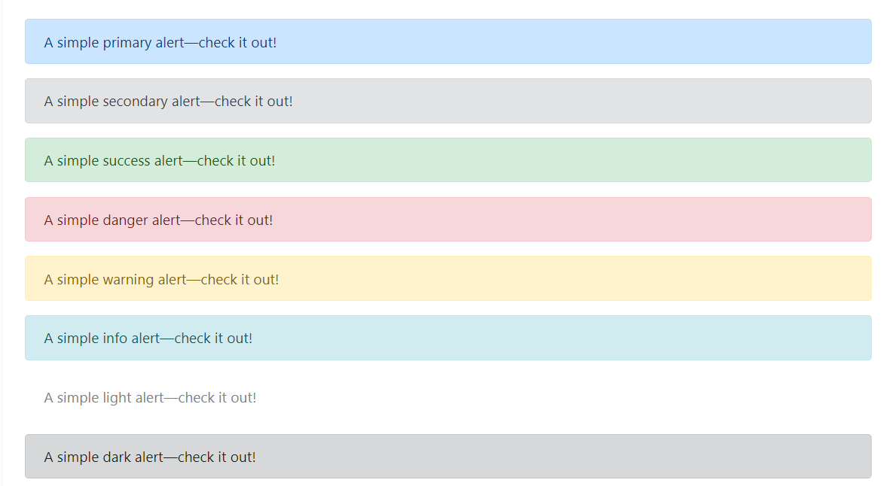
School of Computing Science and Engineering Course Code : R1UC602C Course Name: Web Technology
FRONT END DESIGN USING CSS3 AND BOOTSTRAP FRAMEWORK
Unit-2
BOOTSTRAP FRAMEWORK
Bootstrap Alerts
Program Name: BTech

Slide 73
School of Computing Science and Engineering Course Code : R1UC602C Course Name: Web Technology
FRONT END DESIGN USING CSS3 AND BOOTSTRAP FRAMEWORK
Unit-2
BOOTSTRAP FRAMEWORK
Bootstrap Form Elements
Bootstrap forms. A form facilitate user to enter data such as name, email address, password etc, which can then be sent to server for processing. Bootstrap provides classes to create a variety of forms with varied styles, layouts and custom components.
Form controls in Bootstrap extend Rebooted form styles with classes. For consistent rendering across browsers and devices with customized display, use these classes .
To use more recent input controls, such as email verification, number selection, and other features, be sure to use an appropriate type attribute on all inputs (e.g., email for email addresses or the number for numerical data).
Program Name: BTech

Slide 74
School of Computing Science and Engineering Course Code : R1UC602C Course Name: Web Technology
FRONT END DESIGN USING CSS3 AND BOOTSTRAP FRAMEWORK
Unit-2
BOOTSTRAP FRAMEWORK
Bootstrap Form Elements
<meta name="viewport" content="width=device-width, initial-scale=1.0"> <link href="https://cdn.jsdelivr.net/npm/bootstrap@5.3.0-alpha3/dist/css/bootstrap.min.css" rel="stylesheet"> <script src="https://cdn.jsdelivr.net/npm/bootstrap@5.3.0-alpha3/dist/js/bootstrap.bundle.min.js"></script> </head>
<body> <form> <div class="mb-3"> <label for=" sampleInputEmail" class="form-label">Username</label> <input type="email" class="form-control" id=" sampleInputEmail" aria-describedby="emailHelp"> </div> <div class="mb-3"> <label for="sampleInputPassword" class="form-label">Password</label> <input type="password" class="form-control" id="sampleInputPassword"> </div> <div class="mb-3 form-check"> <input type="checkbox" class="form-check-input" id="sampleCheck"> <label class="form-check-label" for="sampleCheck">Remember me</label> </div> <button type="submit" class="btn btn-primary">Log in</button> </form> </body> </html>
Program Name: BTech

Slide 75
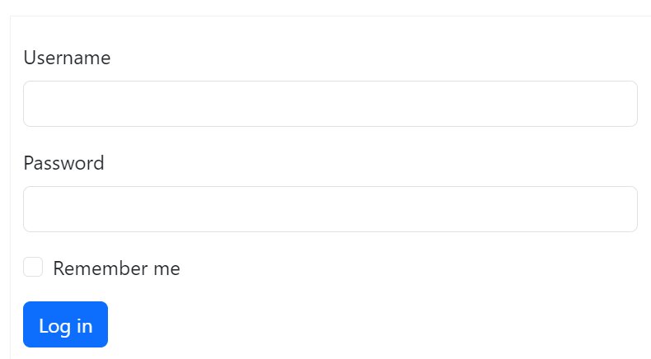
School of Computing Science and Engineering Course Code : R1UC602C Course Name: Web Technology
FRONT END DESIGN USING CSS3 AND BOOTSTRAP FRAMEWORK
Unit-2
BOOTSTRAP FRAMEWORK
Bootstrap Form Elements
Program Name: BTech

Slide 76
School of Computing Science and Engineering Course Code : R1UC602C Course Name: Web Technology
FRONT END DESIGN USING CSS3 AND BOOTSTRAP FRAMEWORK
Unit-2
Representing Web Data
Basic XML
XM L BASICS - XML is not a markup language. It is meta markup language that specifies rules for creating markup languages.When designing markup language using XML, the designer must define a collection of tags that are useful in the intended area.
- XML tag and its content, together with the closing tag is called element
XML has no hidden specifications. Therefore XML documents are plain text that is easily readable by both people and application programs.
- XML based markup language is called tag set.
Program Name: BTech

Slide 77
School of Computing Science and Engineering Course Code : R1UC602C Course Name: Web Technology
FRONT END DESIGN USING CSS3 AND BOOTSTRAP FRAMEWORK
Unit-2
Representing Web Data
Basic XML
A document that uses XML-based markup language is called an XML document.
many XML-oriented text editors assist with the creation and maintenance of XML documents. Eg: Altova XMLspy, XMLFox etc.
An XML application is a program that processes information stored in an XML document.
- An XML processor is a program that parses XML documents and provides the parts to an application .
Program Name: BTech

Slide 78
School of Computing Science and Engineering Course Code : R1UC602C Course Name: Web Technology
FRONT END DESIGN USING CSS3 AND BOOTSTRAP FRAMEWORK
Unit-2
Representing Web Data
Basic XML
Application programs that process the data in XML documents must analyze the documents before they gain access to the data.
This analysis is performed by an XML processor, which has several tasks, one of which is to parse XML documents, a process that isolates the constituent parts (such as tags, attributes, and data strings) and provides them to an application.
- All contemporary browsers support XML. Both IE7 and FX2 support basic XML .
Program Name: BTech

Slide 79
School of Computing Science and Engineering Course Code : R1UC602C Course Name: Web Technology
FRONT END DESIGN USING CSS3 AND BOOTSTRAP FRAMEWORK
Unit-2
Representing Web Data
Basic XML
.THE SYNTAX OF XML/ XML SYNTAX RULES The syntax of XML can be thought of at two distinct levels.
There is the general low-level syntax of XML that imposes its rules on all XML documents.
Either document type definitions or XML schemas specify the other syntactic level. These two kinds of specifications impose structural syntactic rules on documents written with specific XML tag sets.
DTDs and XML schema specify the set of tags and attributes that can appear in particular document or collection of documents, and also the orders and various arrangements in which they can appear.
- DTD‘s and XML schema can be used to define a XML markup language. - All XML documents begin with XML declaration. <?xml version =“1.0” encoding=“utf-8” ?>
Program Name: BTech

Slide 80
School of Computing Science and Engineering Course Code : R1UC602C Course Name: Web Technology
FRONT END DESIGN USING CSS3 AND BOOTSTRAP FRAMEWORK
Unit-2
Representing Web Data
Basic XML
It identifies the document as being XML and provides the version no. of the XML standard being used. It will also include an encoding standard. XML documents can include several different kinds of statements.
1) Data elements
2) Markup declarations - instructions to XML parser
3) Processing instructions – instructions for an applications program that will process the data described in the document.
Program Name: BTech

Slide 81
School of Computing Science and Engineering Course Code : R1UC602C Course Name: Web Technology
FRONT END DESIGN USING CSS3 AND BOOTSTRAP FRAMEWORK
Unit-2
Representing Web Data
Basic XML Rules
All XML document must begin with XML declaration. It identifies the document as being XML and provides the version no. of the XML standard being used. It will also include encoding standard.
• Comments in XML are same as HTML <!-- This is a comment -->
• XML names must begin with a letter or underscore and can include digits, hyphens, and periods.
• XML names are case sensitive. , the tag <Letter> is different from the tag <letter>.
• There is no length limitation for names.
Program Name: BTech

Slide 82
School of Computing Science and Engineering Course Code : R1UC602C Course Name: Web Technology
FRONT END DESIGN USING CSS3 AND BOOTSTRAP FRAMEWORK
Unit-2
Representing Web Data
Basic XML Rules
Space is Preserved in XML
• HTML truncates multiple white-space characters to one single white-space: With XML, the whitespace in a document is not truncated.
• In XML closing tags are necessary.
• In XML, all elements must be properly nested within each other: • XML Documents Must Have a Root Element . It contain one element that is the parent of all other elements. This element is called the root element. <root> <child> <subchild>.....</subchild> </child> </root> • XML tags can have attributes, which are specified with name/value assignments. XML Attribute Values must be enclosed with single or double quotation marks. XML document that strictly adheres to these syntax rule is considered as well formed.
Program Name: BTech

Slide 83
School of Computing Science and Engineering Course Code : R1UC602C Course Name: Web Technology
FRONT END DESIGN USING CSS3 AND BOOTSTRAP FRAMEWORK
Unit-2
Representing Web Data
DOCUMENT TYPE DECLARATION 1.A Document Type Declaration is a statement embedded in an XML document whose purpose is to acknowledge the existence and location of Document Type Definition(DTD).
2.Document Type Declaration is a statement that points to the Document Type Definition(DTD) .
3.Document Type Definition is a set of rules that defines the structure of an XML document where as a Document Type Declaration is a statement that tells the parser which DTD to use for checking and validation.
Program Name: BTech

Slide 84
School of Computing Science and Engineering Course Code : R1UC602C Course Name: Web Technology
FRONT END DESIGN USING CSS3 AND BOOTSTRAP FRAMEWORK
Unit-2
Representing Web Data
DOCUMENT TYPE DECLARATION
4.All Document Type Declaration starts with a string “<!DOCTYPE ”
5.The Document Type Declaration can be external or internal
6.If external the DTD must be specified either as SYSTEM or PUBLIC.
7.If PUBLIC the DTD can be used by anyone by referring the URL.
8.If SYSTEM that means it resides on local harddisk and may not be available for use by other application. For example suppose there is an XML document called myfile.xml that we want to parse and validate against a DTD called my-rules.dtd .
Program Name: BTech

Slide 85
School of Computing Science and Engineering Course Code : R1UC602C Course Name: Web Technology
FRONT END DESIGN USING CSS3 AND BOOTSTRAP FRAMEWORK
Unit-2
Representing Web Data
DOCUMENT TYPE DECLARATION
The DTD for a document can be
internal (embedded in XML document) or
external (separate file)- can be used with more than one document.
• DTD declarations have the form: <!keyword … >
• There are four possible declaration keywords:
• ELEMENT, ATTLIST, ENTITY, and NOTATION
• ELEMENT- used to define tags
• ATTLIST – used to define tag attributes
• ENTITY- used to define entities
• NOTATION – used to define datatype notations
Program Name: BTech

Slide 86
School of Computing Science and Engineering Course Code : R1UC602C Course Name: Web Technology
FRONT END DESIGN USING CSS3 AND BOOTSTRAP FRAMEWORK
Unit-2
Representing Web Data
DOCUMENT TYPE DECLARATION
Declaring attributes An attribute declaration must include the name of the element to which the attribute belongs, the attribute name and its type. Syntax
• <!ATTLIST element-name attribute_name attribute type [defaultvalue]>
If More than one attribute • <!ATTLIST element_name attribute_name1 attribute_type default_value_1 attribute_name2 attribute_type default_value_2>
Program Name: BTech

Slide 87
School of Computing Science and Engineering Course Code : R1UC602C Course Name: Web Technology
FRONT END DESIGN USING CSS3 AND BOOTSTRAP FRAMEWORK
Unit-2
Representing Web Data
DOCUMENT TYPE DECLARATION
Attribute type :There are ten different types, but we will consider only CDATA . • Possible Default value for attributes:
• Value - value ,which is used if none is specified in an element (as default) • #Fixed value - value ,which every element have and can‘t be changed (as constant)
• # Required - no default value is given ,every instance must specify a value • #Implied - no default value is given ,the value may or may not be specified (optional)
• Example : <!ATTLIST car doors CDATA "4"> <!ATTLIST car engine_type CDATA #REQUIRED> <!ATTLIST car make CDATA #FIXED "Ford"> <!ATTLIST car price CDATA #IMPLIED> The following xml element is valid for this DTD <car doors = "2" engine_type = "V8">
Program Name: BTech

Slide 88
School of Computing Science and Engineering Course Code : R1UC602C Course Name: Web Technology
FRONT END DESIGN USING CSS3 AND BOOTSTRAP FRAMEWORK
Unit-2
Representing Web Data
DOCUMENT TYPE DECLARATION
Attribute that include fixed in the DTD may or may not be specified in particular element instances.
+ - one or more occurrences
* - zero or more occurrences
? - zero or one occurrence
• Eg DTD Declaration <!ELEMENT person (parent+, age, spouse?, sibling* )> Means parent element can occur one or more times, spouse element can occur zero or one time. Sibling element can occur zero or more times.
Program Name: BTech

Slide 89
School of Computing Science and Engineering Course Code : R1UC602C Course Name: Web Technology
FRONT END DESIGN USING CSS3 AND BOOTSTRAP FRAMEWORK
Unit-2
Representing Web Data
DOCUMENT TYPE DECLARATION
INTERNAL DTD
• If the DTD’s are internal then the syntax is
• <!DOCTYPE root-element [<!internal type definition>]> <?xml version=”1.0” encoding=”utf-8”?>
<!DOCTYPE mail [ <!ELEMENT mail(to,from,heading,body)>
<!ELEMENT to (#PCDATA)> <!ELEMENT from (#PCDATA)> <!ELEMENT heading (#PCDATA)> <!ELEMENT body (#PCDATA)>]> <mail> <to>Rani</to> <from>Ravi</from> <heading>Remainder</heading> <body>About our parents Wedding Anniversary</body> </mail>
Program Name: BTech

Slide 90
School of Computing Science and Engineering Course Code : R1UC602C Course Name: Web Technology
FRONT END DESIGN USING CSS3 AND BOOTSTRAP FRAMEWORK
Unit-2
Representing Web Data
DOCUMENT TYPE DECLARATION
EXTERNAL DTD
• The DTD section can be placed in an external file .
• If the Document Type Declaration is external then the DTD must be specified either as SYSTEM or PUBLIC in the Document Type Declaration.
• If the DTD’s are external then the syntax is <!DOCTYPE root-element SYSTEM “DTD_file_URL”> or <!DOCTYPE root-element PUBLIC “public_id” “DTD_file_URL” >
• If SYSTEM the DTD resides on the local hard disk and may not be available for use by other applications. If PUBLIC the DTD can be used by anyone by referring the URL . The public_id is unique for standard DTD files on the web.
• //mail.xml
Program Name: BTech

Slide 91
School of Computing Science and Engineering Course Code : R1UC602C Course Name: Web Technology
FRONT END DESIGN USING CSS3 AND BOOTSTRAP FRAMEWORK
Unit-2
Representing Web Data
DOCUMENT TYPE DECLARATION
EXTERNAL DTD
<?xml version=”1.0” encoding = “utf-8”?> <!DOCTYPE mail SYSTEM “mail.dtd”> <mail> <to>Rani</to> <from>Ravi</from> <heading>Remainder </heading>
<body>About our parents Wedding Anniversary</body> </mail> //mail.dtd <?xml version=”1.0”?>
<!ELEMENT mail(to,from,heading,body)>
<!ELEMENT to (#PCDATA)>
<!ELEMENT from #PCDATA)>
<!ELEMENT heading (#PCDATA)>
<!ELEMENT body (#PCDATA)>
Program Name: BTech

Slide 92
School of Computing Science and Engineering Course Code : R1UC602C Course Name: Web Technology
FRONT END DESIGN USING CSS3 AND BOOTSTRAP FRAMEWORK
Unit-2
Representing Web Data
XML NAMESPACES
• Xml namespaces provide a method to avoid element name conflicts.
• In xml, element names are defined by the developer. This often results in a conflict when trying to mix xml documents from different xml applications.
• An example of this situation is having a <table> tag for a category of furniture and a <table>tag from HTML for information tables.
• This xml carries html table information:
Program Name: BTech

Slide 93
School of Computing Science and Engineering Course Code : R1UC602C Course Name: Web Technology
FRONT END DESIGN USING CSS3 AND BOOTSTRAP FRAMEWORK
Unit-2
Representing Web Data
XML NAMESPACES
<table> <tr> <td>apples</td> <td>bananas</td> </tr> </table>
• This xml carries information about a table (a piece of furniture):
<table> <name> coffee table</name> <width>80</width> <length>120</length> </table>
If these xml fragments were added together, there would be a name conflict. Both contain a <table> element, but the elements have different content and meaning.
An xml parser will not know how to handle these differences.
Program Name: BTech

Slide 94
School of Computing Science and Engineering Course Code : R1UC602C Course Name: Web Technology
FRONT END DESIGN USING CSS3 AND BOOTSTRAP FRAMEWORK
Unit-2
Representing Web Data
XML NAMESPACES
Xml namespaces provide a method to avoid element name conflicts.
• In xml, element names are defined by the developer. This often results in a conflict when trying to mix xml documents from different xml applications.
• An example of this situation is having a <table> tag for a category of furniture and a <table>tag from HTML for information tables.
• This xml carries html table information:
Program Name: BTech

Slide 95
School of Computing Science and Engineering Course Code : R1UC602C Course Name: Web Technology
FRONT END DESIGN USING CSS3 AND BOOTSTRAP FRAMEWORK
Unit-2
Representing Web Data
XML NAMESPACES
<table>
<tr>
<td>apples</td>
<td>bananas</td>
</tr>
</table>
• This xml carries information about a table (a piece of furniture):
<table>
<name>coffee table</name>
<width>80</width>
<length>120</length>
</table>
Program Name: BTech

Slide 96
School of Computing Science and Engineering Course Code : R1UC602C Course Name: Web Technology
FRONT END DESIGN USING CSS3 AND BOOTSTRAP FRAMEWORK
Unit-2
Representing Web Data
XML NAMESPACES
If these xml fragments were added together, there would be a name conflict. Both contain a <table> element, but the elements have different content and meaning. An xml parser will not know how to handle these differences.
An XML namespace is a collection of element and attribute names used in XML documents. The name of the namespace usually has the form of a URL. But the XML processors never reference the site whose URL is used as the name of a namespace.
The purpose of the URL is to give the namespace a unique name.
The namespaces can be declared as the value of xmlns in the elements where they are used or in the xml root element.
Program Name: BTech

Slide 97
School of Computing Science and Engineering Course Code : R1UC602C Course Name: Web Technology
FRONT END DESIGN USING CSS3 AND BOOTSTRAP FRAMEWORK
Unit-2
Representing Web Data
XML NAMESPACES
SOLVING THE NAME CONFLICT USING A PREFIX
• Name conflicts in xml can easily be avoided using a name prefix.
• This xml carries information about an html table, and a piece of furniture:
<h:table>
<h:tr>
<h:td>apples</h:td>
<h:td>bananas</h:td>
</h:tr>
</h:table>
<f:table>
<f:name>coffee table</f:name>
<f:width>80</f:width>
<f:length>120</f:length>
</f:table>
• In the example above, there will be no conflict because the two <table> elements have different names.
Program Name: BTech

Slide 98
School of Computing Science and Engineering Course Code : R1UC602C Course Name: Web Technology
FRONT END DESIGN USING CSS3 AND BOOTSTRAP FRAMEWORK
Unit-2
Representing Web Data
XML SCHEMAS
An XML schema is an XML document so it can be parsed with an XML parser.
Schema Fundamentals:
• Schema are related idea of class and an object in an OOP language. A Schema is similar to a class definition ;an XML document that conforms to a specific schema are considered instances of that schema or object of the schema’s class.
• Schemas have three primary purposes
- Specify elements and attributes of an XML language
- Specify the structure of its instance XML documents including where and how often the elements may appear.
- Specify the data type of every element in its instance XML documents
Program Name: BTech

Slide 99
School of Computing Science and Engineering Course Code : R1UC602C Course Name: Web Technology
FRONT END DESIGN USING CSS3 AND BOOTSTRAP FRAMEWORK
Unit-2
Representing Web Data
XML SCHEMAS
Defining a schema:
Schemas are written from a namespace(schema of schemas):
The name of this namespace is http://www.w3.org/2001/XMLSchema element, schema, sequence and string are some names from this namespace Every XML schema has a single root, schema.
• The schema element must specify the namespace for the schema of schemas from which the schema‘s elements and its attributes will be drawn.
It often specifies a prefix that will be used for the names in the schema. This name space specification appears as xmlns:xsd = http://www.w3.org/2001/XMLSchema
Every XML schema itself defines a tag set like DTD, which must be named with the targetNamespace attribute of schema element
Program Name: BTech

Slide 100
School of Computing Science and Engineering Course Code : R1UC602C Course Name: Web Technology
FRONT END DESIGN USING CSS3 AND BOOTSTRAP FRAMEWORK
Unit-2
Representing Web Data
XML SCHEMAS
The target namespace is specified by assigining a name space to the target
namespace attribute as the following:
targetNamespace = http://cs.uccs.edu/planeSchema
Every top-level element places its name in the target namespace If we want to include nested elements(ie if the names of the elements and attributes that are not defined directly in the schema element), we must set the
elementFormDefault attribute to qualified.
elementFormDefault = “qualified”
The default namespace which is source of the unprefixed names in the schema is given with another xmlns specification without the prefix.
Program Name: BTech

Slide 101
School of Computing Science and Engineering Course Code : R1UC602C Course Name: Web Technology
FRONT END DESIGN USING CSS3 AND BOOTSTRAP FRAMEWORK
Unit-2
Representing Web Data
XML SCHEMAS
xmlns = "http://cs.uccs.edu/planeSchema “
A complete example of opening tag for a schema element:
<xsd:schema
<!-- Namespace for the schema itself -->
xmlns:xsd = http://www.w3.org/2001/XMLSchema <!-- Namespace where
elements defined here will be placed -->
targetNamespace = http://cs.uccs.edu/planeSchema
<!-- Default namespace for this document -->
xmlns = http://cs.uccs.edu/planeSchema.
<!-- Specify non-top-level elements to be in the target namespace-->
elementFormDefault = "qualified” >
Program Name: BTech

Slide 102
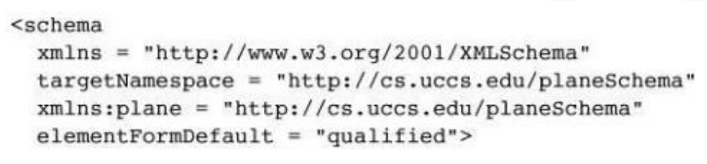
School of Computing Science and Engineering Course Code : R1UC602C Course Name: Web Technology
FRONT END DESIGN USING CSS3 AND BOOTSTRAP FRAMEWORK
Unit-2
Representing Web Data
XML SCHEMAS
One alternative to the preceding opening tag would be to make the XMLSchema names the default so that they do not need to be prefixed in the schema.
Then the names in the target namespace would need to be prefixed. The following schema tag illustrates this approach:
Program Name: BTech

Slide 103
School of Computing Science and Engineering Course Code : R1UC602C Course Name: Web Technology
FRONT END DESIGN USING CSS3 AND BOOTSTRAP FRAMEWORK
Unit-2
Representing Web Data
Document Object Model (DOM)
The Document Object Model (DOM) is a platform- and language-independent standard object model for representing HTML and XML formats.
It defines the logical structure of documents and how they are accessed and manipulated.
The DOM represents an XML document as a tree of nodes, where a DOM document is an instance of org.w3c.dom.Document.
Each node in a DOM document is an instance of some subclass of the Node class org.w3c.dom.Node. Node subclasses include Element, Text, and Comment.
Node properties include nodeName, nodeType, nodeValue, childNodes, firstChild, and lastChild.
The Node interface provides methods that let you determine whether a node has children, its type, and its value. You can use these methods to iterate over, manipulate, and display a DOM document and its nodes.
Program Name: BTech

Slide 104
School of Computing Science and Engineering Course Code : R1UC602C Course Name: Web Technology
FRONT END DESIGN USING CSS3 AND BOOTSTRAP FRAMEWORK
Unit-2
Representing Web Data
EXTENSIBLE STYLE SHEET LANGUAGE (XSL)
XSL is a language for expressing stylesheets
support for browsing, printing, and aural rendering
formatting highly structured documents (XML)
performing complex publishing tasks: tables of contents, indexes, reports,...
addressing accessibility and internationalization issues
written in XM
Program Name: BTech

Slide 105
School of Computing Science and Engineering Course Code : R1UC602C Course Name: Web Technology
FRONT END DESIGN USING CSS3 AND BOOTSTRAP FRAMEWORK
Unit-2
Representing Web Data
Overview of Extensible Stylesheet Language Transformations (XSLT)
XSLT processors take both an XML document and an XSLT document as input. The XSLT document is the program to be executed; the XML document is the input data to the program.
Parts of the XML document are selected, possibly modified, and merged with parts of the XSLT document to form a new document, which is sometimes called an XSL document. Note that the XSL document is also an XML document, which could be again the input to an XSLT processor.
The output document can be stored for future use by applications, or it may be immediately displayed by an application, often a browser.
Neither the XSLT document nor the input XML document is changed by the XSLT processor.
Program Name: BTech

Slide 106
School of Computing Science and Engineering Course Code : R1UC602C Course Name: Web Technology
FRONT END DESIGN USING CSS3 AND BOOTSTRAP FRAMEWORK
Unit-2
Representing Web Data
The standard way to transform XML data into other formats is by Extensible Stylesheet Language Transformations (XSLT). You can use the built-in XSLTRANSFORM function to convert XML documents into HTML, plain text, or different XML schemas.
XSLT uses stylesheets to convert XML into other data formats. You can convert part or all of an XML document and select or rearrange the data using the XPath query language and the built-in functions of XSLT.
XSLT is commonly used to convert XML to HTML, but can also be used to transform XML documents that comply with one XML schema into documents that comply with another schema.
Program Name: BTech

Slide 107
School of Computing Science and Engineering Course Code : R1UC602C Course Name: Web Technology
FRONT END DESIGN USING CSS3 AND BOOTSTRAP FRAMEWORK
Unit-2
Representing Web Data
XSLT can also be used to convert XML data into unrelated formats, like comma-delimited text or formatting languages such as troff. XSLT has two main areas of applicability:Formatting (conversion of XML into HTML or formatting languages such as FOP);
Data exchange (querying, reorganizing and converting data from one XML schema to another, or into a data exchange format such as SOAP)
Program Name: BTech

Slide 108


